Slide 1
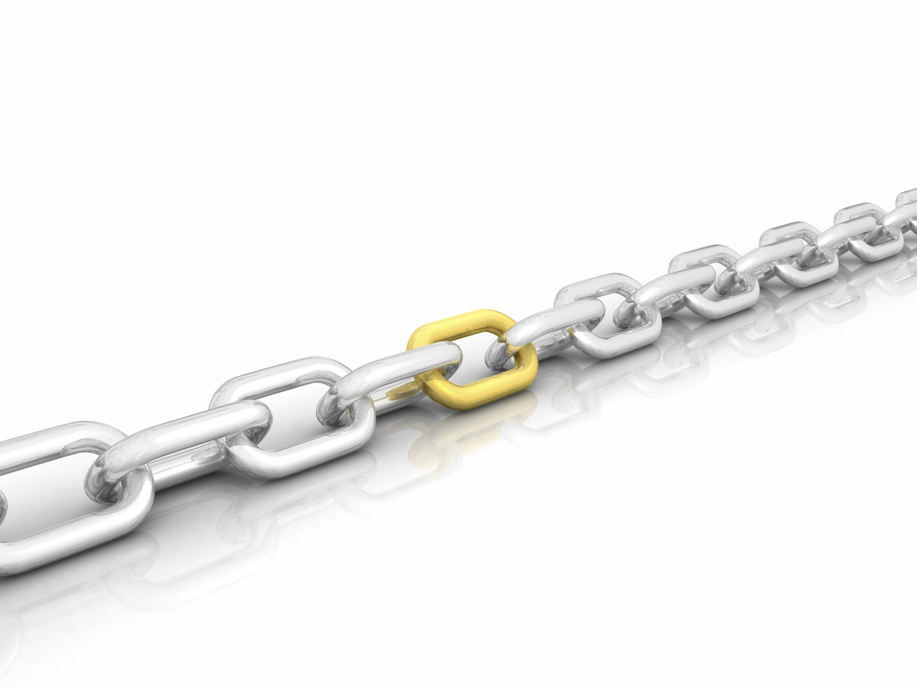
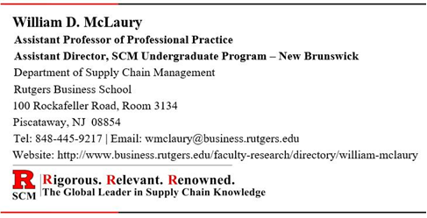
Supply Chain
Management
Supply Chain Planning

Slide 2
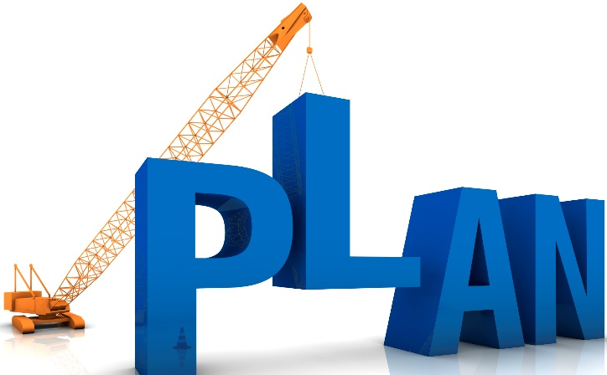
Supply Chain Planning - Introduction
Supply Chain Planning is the element of supply chain management responsible for determining how best to satisfy the requirements created by the Demand Plan.
Its objective is to balance supply and demand in a way that realizes the financial and service objectives of the company.
  Operations managers are continuously involved in planning operations and resources to balance capacity and output.
Supply Chain Planning is a combination of all the planning processes that are used across the supply chain, primarily:
  Aggregate Production Planning (APP)
  Master Production Scheduling (MPS)
  Materials Requirement Planning (MRP)
  Distribution Requirements Planning (DRP)
  Capacity Planning

Slide 3
Supply Chain Planning
Supply chain planning is usually hierarchical and can be divided into three broad categories:
  Long-Range – involves planning for actions such as the construction of facilities and major equipment purchase (ref., Aggregate Production Plan - APP) .
  Executive level - Ford Motor Company wants to grow the market by 3% (1 - 3 years)
  Intermediate-Range – Shows the quantity and timing of end items (ref., Master Production Schedule – MPS)
  Mid-level - Ford Motor Company wants to make 1,000 F-150 pick up trucks/week for the next 3-18 months.
  Short-Range – detailed planning process for components and parts to support the master production schedule (ref., Materials Requirement Planning – MRP)
  Planner, 1st line Supervisor – 1,000 engines, 1,000 transmissions, seats, windows, etc. each week over the next 1-12 weeks.

Slide 4
Planning Responsibilities and Tasks
Planning Tasks and Horizon →
Long-Range
(over 1 year)
R&D
New product plans
Capital expenses
Facility expansion
Top
Management
Intermediate-Range
(3 – 18 months)
Sales planning
Production planning
Setting employment, inventory, and subcontracting levels
Analyzing operating plans
Operations
Middle-Management
Short-Range
(up to 3 months)
Job assignments
Job scheduling
Dispatching
Ordering
Operations
Managers, Supervisor, Foremen, etc.
Responsibility

Slide 5
Supply Chain Planning Diagram
Strategic
Plans
Financial
Plans
Sequence of supply chain planning processes, from top to bottom, and their relationship to each other.
Business Planning
Sales & Operations Planning (S&OP)
Long
Range
Demand
Management
Resource
Requirements
Planning (RRP)
Aggregate Production
Planning (APP)
Supply
Management
Intermediate
Range
Rough-Cut
Capacity
Planning (RCCP)
Master Production
Scheduling (MPS)
Capacity
Requirements
Planning (CRP)
Material
Requirements
Planning (MRP)
Short
Range
Suppliers
Manufacturing
(Internal or External)
Distribution
Requirements
Planning (DRP)

Slide 6
Business Planning
Strategic
Plans
Business Planning
Financial
Plans
The Business Plan, with its long-term focus, provides the company’s direction and objectives for the next two to ten years.
Management gathers input from the various organizational functions such as finance, marketing, operations, and engineering, to develop the Business Plan.
The plan states the company’s objectives for profitability, growth rate, and return on investment
It is then typically updated and reevaluated annually.
It is also typically used as the starting point for developing the organization’s Production Plan or Aggregate Production Plan.

Slide 7
Sales & Operations Planning (S&OP)
Strategic
Plans
Business Planning
Financial
Plans
Sales & Operations Planning (S&OP)
Demand
Management
Resource
Requirements
Planning (RRP)
Aggregate Production
Planning (APP)
Supply
Management
A process that brings all the demand and supply plans for the business (sales, marketing, development, production, sourcing, and finance) together to provide management with the ability to strategically direct the business to achieve a competitive advantage
It is the definitive statement of the company’s plans for the near to intermediate term, covering a horizon sufficient to plan for resources, and to support the annual business planning process.
It links the strategic plans for the business with its execution.
It is performed at least once a month and is reviewed by management at an aggregate (product family) level.

Slide 8
Aggregate Production Plan (APP)
Hierarchical planning process that translates annual business, marketing plans, and demand forecasts into a production plan for a product family* in a plant or facility.
Strategic
Plans
Business Planning
Financial
Plans
  The planning horizon of APP is at least one year and is usually rolled forward by three months every quarter.
  Includes those costs relevant to aggregate planning decisions:
    inventory, setup, machine operation, hiring, firing, training, and overtime costs.
Sales & Operations Planning (S&OP)
Demand
Management
Resource
Requirements
Planning (RRP)
Aggregate Production
Planning (APP)
Supply
Management
* Product Family = products that share similar characteristics

Slide 9

Aggregate Planning - Purpose and Goals
Primary purpose is to establish production rates that will achieve management’s objective of satisfying customer demand by maintaining, raising, or lowering inventories, while attempting to keep the workforce relatively stable.
Meet demand
Use capacity efficiently
Meet inventory policy
Minimize cost:
  Labor
  Inventory
  Plant and Equipment
  Subcontract
Notes:
At this point, we are making the decisions as to “how” we will meet the aggregate schedules, and “when” each major task with be performed.

Slide 10

Aggregate Planning Strategies – Demand Options
  Influencing demand - so that it aligns to available production capacity (e.g., airline and hotel weekend discounts, telecommunication companies’ weekend rates):
    Advertising
    Promotional plans
    Pricing
  Backordering during high demand periods – accept demand greater than supply capabilities.
  Counter-seasonal product mixing - Develop a product mix with antithetic (seasonal) trends that level the cumulative required production capacity (e.g., lawn mowers and snow blowers)
Notes:
This slide and the next list various scheduling strategies. The four slides following provide a framework for discussing the advantages and disadvantages of the pure strategies.

Slide 11
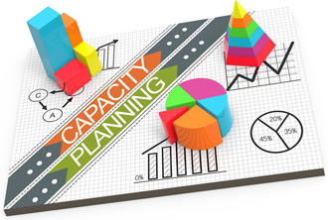
Aggregate Planning Strategies – Supply Options
  Change inventory levels
  Increase inventories – build stock in advance of demand in order to use available capacity
  Decrease inventories – temporarily reduce inventory below normal safety stock levels during peak demand periods to meet customer requirements.
  Change capacity:
  Vary production output through overtime or idle time
  Vary work force size by hiring or layoff
  Using part-time workers
  Subcontracting
Notes:
This slide and the next list various scheduling strategies. The four slides following provide a framework for discussing the advantages and disadvantages of the pure strategies.

Slide 12
Master Production Schedule (MPS)
A detailed disaggregation of the aggregate production plan (APP), listing the exact end items to be produced by a specific period.
Aggregate Production
Planning (APP)
  More detailed than APP and easier to plan under stable demand.
  Planning horizon is shorter than APP, but longer than the lead time to produce the item.
Rough-Cut
Capacity
Planning (RCCP)
Master Production
Scheduling (MPS)
Capacity
Requirements
Planning (CRP)
Material
Requirements
Planning (MRP)
Suppliers
Manufacturing
(Internal or External)

Slide 13
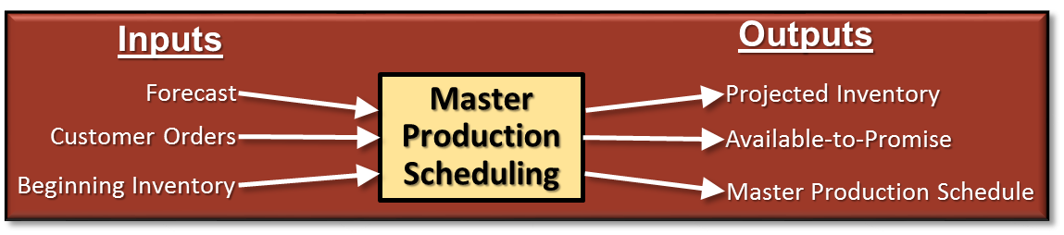
Aggregate Production Plan → Master Production Schedule
Textbook
Pages 73 - 75
Projected Available Balance (from the previous period) + MPS – Customer Orders or Forecast (for the current period) = Projected Available Balance (for the current period)

Slide 14
Time Fencing
  MPS (Master Production Schedule) is the plan that drives the business. Even small changes in the MPS can cause major changes in the detailed production schedule and the material plan, creating nervousness and instability throughout the organization
  To minimize the impact of changes in the MPS, many companies have adopted a time fencing policy separating the planning horizon into a firmed time period and a planned time period:
  Firmed Time Period: From the current date out several weeks into future.
    A Firm Time Fence is established at the outer limit of this period to signify when changes can no longer be made automatically by the planning system.
    Recommended changes must be reviewed and approved by the Master Production Scheduler or an authorized person(s).
  Planned Time Period: From the end of the Firmed Time Period to the end of the planning horizon.
    The planning system is free to create or make changes to planned orders in this time period based on the data and planning logic determined by the company.
Firm Time Fence
Firmed Time Period
Planned Time Period
Week
0
1
2
3
4
5
6
7
8
9
10
11
12
13
14
15
16
17
18
19

Slide 15
Basic Production Strategies
Three basic production strategies:
Level Production Strategy - Relies on a constant output rate while varying inventory and backlog according to fluctuating demand. Firm relies on fluctuating finished goods and backlogs to meet demand. Works well for make-to-stock firms
  Plywood, steel, light bulbs, razors are examples. Maybe the changeover is long, or its inefficient to stop/ start.
Finished Output of
Goods or Services
Backlog or
Inventory
Customer Demand
Workforce
10
Constant Number
of Workers
50
40 Inventory
20
Constant Number
of Workers
50
30 Inventory
80
Constant Number
of Workers
50
30 Backlog
get shortfall from inventory

Slide 16
Basic Production Strategies (continued)
Chase Production Strategy - Adjusts capacity to match demand. Firm hires and lays off workers to match finished output to demand. Finished goods inventory remains constant. Works well for make-to-order firms
  Airplane companies do this since training takes time. Union employees are sent back to the union hall, waiting to be recalled. They collect unemployment. Another example are workers that harvest crops.
Customer
Demand
Finished Output of
Goods or Services
Workforce
10
Fire / Lay-off
10
20
Stable Workforce
20
30
Hire
30

Slide 17
Basic Production Strategies (continued)
Mixed Production Strategy - Maintains stable core workforce while using other short-term means, such as overtime, subcontracting and part time helpers to manage short-term demand.
  Construction co., retail stores at holiday season.
Finished Output of
Goods or Services
Customer Demand
Workforce
10
Stable Workforce
10
20
Work Overtime
20
50
Work Overtime and
Outsource some Output
50
80
Overtime, Part Time Help and Outsource
80

Slide 18

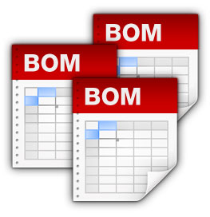
The Bill of Materials
Bill of Materials (BOM) - document that shows an inclusive listing of all component parts and assemblies making up the final product.
  Single Level Bill of Materials - Display of components that are directly used in a parent item, together with the quantity required of each component (i.e., the planning factor). Shows only the relationships one level down
  Multilevel Bill of Materials - A display of all the components directly or indirectly used in a parent, together with the quantity required of each component (i.e., the planning factor). If a component is a subassembly, blend, intermediate, etc., all its components and all their components also will be exhibited, down to purchased parts and raw materials

Slide 19
Single Level Bill of Materials
Example
Single Level Bill of Materials
Independent Demand - The external demand for an item that is unrelated to the demand for other items (e.g., finished product). The demand for these items is forecasted and can be affected by trends, seasonal patterns, and market conditions.
Table | Quantity Per *
Leg | 4
End | 2
Side | 2
Top | 1
Hardware Kit | 1
Dependent Demand - the internal demand for items that are assembled or combined to make up the final product (e.g., component parts). Demand for these items is calculated based on the demand of the final product in which the parts are used, by using the planning factor.
* Planning Factor

Slide 20
Multilevel Bill of Materials
Example
Finished
Product
Bicycle
Level 0
(Independent Demand)
Frame
Front Fork
Wheel
Assembly
Handle Bar
Seat
Gear Assembly
Level 1
(Dependent Demand)
(1)
(1)
(2)
(1)
(1)
(1)
Components
Rim
Spokes
Tire
Level 2
(Dependent Demand)
(1)
(10)
(1)
Raw
Materials
12” Bar Aluminum
1 kg Rubber
Level 3
(Dependent Demand)
(½)
(1/10)
(¼)
(#) = Planning Factor

Slide 21
Supply Chain Planning Diagram
Strategic
Plans
Financial
Plans
Sequence of supply chain planning processes, from top to bottom, and their relationship to each other.
Business Planning
Sales & Operations Planning (S&OP)
Long
Range
Demand
Management
Resource
Requirements
Planning (RRP)
Aggregate Production
Planning (APP)
Supply
Management
)
Intermediate
Range
Rough-Cut
Capacity
Planning (RCCP)
Master Production
Scheduling (MPS)
Capacity
Requirements
Planning (CRP)
Material
Requirements
Planning (MRP)
Short
Range
Suppliers
Manufacturing
(Internal or External)
Distribution
Requirements
Planning (DRP)

Slide 22
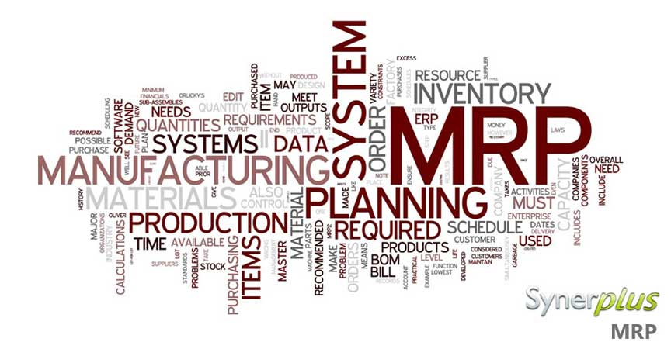
Material Requirements Planning (MRP)
MRP - A computer-based materials management system that calculates the exact quantities, need dates, and planned order releases for subassemblies, component parts and materials required to manufacture a final product.
MRP requires:
    The independent demand information, i.e., finished product forecast
    Parent-component relationships from BOM
    Inventory status of final product and each of the components and materials.
    Planned order releases (output of MRP)

Slide 23
Terms Used in MRP
  Gross Requirement – A time-phased requirement prior to netting out on-hand inventory and lead-time
  Net Requirement – The unsatisfied item requirement for a specific time period. Gross requirement for period minus current on-hand inventory.
  Projected On-Hand Inventory – Projected closing inventory at end of a period. Beginning inventory minus gross requirements, plus scheduled receipts plus planned receipts from planned order releases.
  Planned Order Release – A specific order for a specific item and quantity to be released to the shop or to the supplier.
  Firmed Planned Order – A planned order that can be frozen in quantity and time so that the MRP computer logic cannot automatically change when conditions change. Established by the Planner or Supply Chain Manager to prevent system nervousness. This can aid planners working with MRP systems to respond to material and capacity problems by firming up selected planned orders.
  Scheduled Receipt – A committed order awaiting delivery for a specific period.

Slide 24
Terms Used in MRP (continued)
  Time Bucket – Unit of time / time period used in MRP, e.g., days, weeks, months
  Parent – Item generating demand for lower-level components.
  Components – parts demanded by a parent.
  Planning factor – The number/quantity of each component or material needed to produce a single unit of the parent item
  MRP Explosion – The process of converting a parent item’s planned order releases into component gross requirements
  Pegging – Relates the gross requirements for a component part to the planned order releases of the parent item, so as to identify the source(s) of the item’s gross requirements. Pegging can be thought of as active where-used information.
  Lot Size – order size for MRP logic
  Safety Stock – a quantity of stock planned to be in inventory to protect against fluctuations in demand or supply. Over planning supply versus demand can be used to create safety stock.

Slide 25
Example
Textbook
Pages 86 - 88
“MRP explosion”

Slide 26
Supply Chain Planning Diagram
Strategic
Plans
Financial
Plans
Sequence of supply chain planning processes, from top to bottom, and their relationship to each other.
Business Planning
Sales & Operations Planning (S&OP)
Long
Range
Demand
Management
Resource
Requirements
Planning (RRP)
Aggregate Production
Planning (APP)
Supply
Management
Intermediate
Range
Rough-Cut
Capacity
Planning (RCCP)
Master Production
Scheduling (MPS)
Capacity
Requirements
Planning (CRP)
Material
Requirements
Planning (MRP)
Short
Range
Suppliers
Manufacturing
(Internal or External)
Distribution
Requirements
Planning (DRP)

Slide 27
Capacity Planning
Determining the amount of capacity required to produce a good or service in the future.
Organizations must balance the production plan with capacity. This directly impacts how effectively the organization deploys its resources in producing goods.
The following are the major capacity planning tools:
Resource Requirement Planning (RRP) A long-range capacity planning module used to check whether aggregate resources (i.e., labor and manpower) are capable of satisfying the Aggregate Production Plan.
Rough-Cut Capacity Planning (RCCP) A medium-range capacity planning module used to check the feasibility of the Master Production Schedule. Converts MPS from the production needed to the capacity required, then compares it to capacity available.
Capacity Requirement Planning (CRP) A short-range capacity planning module used to check the feasibility of the Material Requirements Plan.
Resource
Requirements
Planning (RRP)
Aggregate Production
Planning (APP)
Rough-Cut
Capacity
Planning (RCCP)
Master Production
Scheduling (MPS)
Capacity
Requirements
Planning (CRP)
Material
Requirements
Planning (MRP)
Suppliers
Manufacturing
(Internal or External)

Slide 28
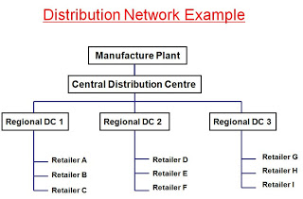
Distribution Requirements Planning (DRP)
A time-phased finished good inventory replenishment plan in a distribution network. The function of determining the need to replenish inventory at branch warehouses.
  DRP is a logical extension of the MRP system and ties physical distribution to the manufacturing planning and control system
Key elements necessary for DRP:
Forecast demands by DC
Current inventory levels by DC
Target safety stock by DC
Recommended replenishment quantities
Replenishment lead times

Slide 29
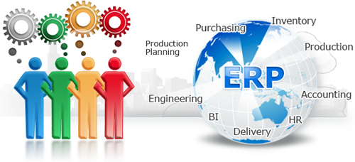
Enterprise Requirements Planning Systems (ERP)
Information system connecting all functional areas and operations of an organization, and in some cases suppliers and customers, via common software infrastructure and database
  ERP provides a means for supply chain members to share information so that scarce resources can be fully utilized to meet demand, while minimizing supply chain inventories

Slide 30
Development of ERP Systems
Accounting and Finance
Engineering R&D
Sales & Marketing
Central Database
with Master Data
Supplier Relationship Management
Customer Relationship Management
Suppliers
Customers
Logistics
Human Resources
Operations

Slide 31
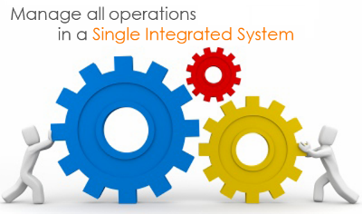
Implementing ERP Systems
Two Types of Implementation
Best-of-breed - pick the best application for each individual function. Disadvantage - software may not integrate well but this may not be a major issue in future
Single integrator solution - pick all the desired applications from a single vendor
Implementation Problems:
      Lack of top management commitment
      Lack of adequate resources
      Lack of proper training
      Lack of communication
      Incompatible system environment

Slide 32


Advantages and Disadvantages of ERP Systems
Advantages
  Added visibility leads to reduced supply chain inventories
  Helps to standardize manufacturing processes
  Measure performance and communicate via a standardized method
Disadvantages
  Substantial time and capital investment
  Complexity
  Firms adapt processes to meet ERP system

Slide 33
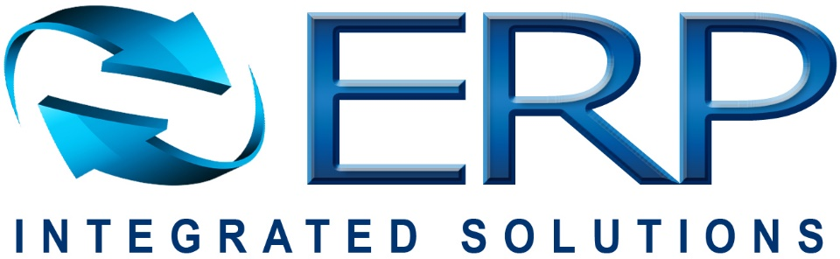
ERP Software Applications and Providers
Major ERP applications include:
  Accounting and Finance
  Customer Relationship Management
  Human Resource Management
  Manufacturing
  Supplier Relationship Management
  Supply Chain Management
The 3 major ERP providers are:
  SAP
  Oracle
  Microsoft
  Other small software firms provide applications (e.g., Sage’s MAS 90) as well as full ERP solutions, but lack applistructure (the amalgamation of enterprise applications and technological infrastructure)

